Slide 1

ReStyle: A Residual-Based StyleGAN Encoder via Iterative Refinement
ReStyle
Kim Ha Yeon
Bachelor Student, UNIST
27th October, 2022

Slide 2
Summary
“Several forward passes by feeding the encoder with the output of the previous iteration along with the original input image”

Slide 3
Introduction
GAN inversion
Optimization
Learning Encoder : 기존의 방식은 encoder가 real 이미지가 latent code로 mapping할 수 있도록 single-pass로 훈련시킨다.
Signle pass여서 빠르게 edit이 가능한 영역으로 수렴시키지만, reconstruction accuracy가 optimization방법보다 현저히 떨어진다.
Single shot으로 정확한 inversion을 얻는 것은 힘드므로 iterative feedback mechanism(small num)으로 inversion을 수행한다.
which image regions are refined at each iterative feedback step demonstrating that our scheme operates
in a coarse-tofine manner.
2) the absolute magnitude of change at each step decreases, with the predicted residuals converging
after only a small number of steps.
3) Encoder bootstrapping : leverage two well-trained encoders to obtain a more faithful translation of a given real image.

Slide 4
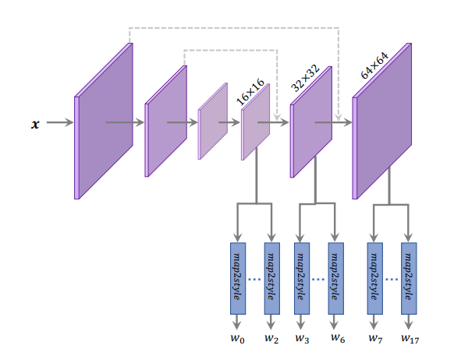
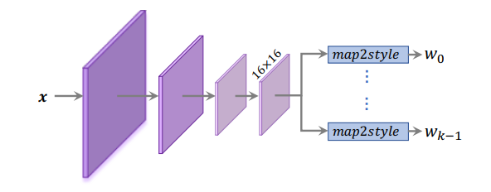
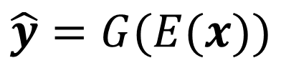
Method
■ Encoder-Based Inversion Methods(Original)
Encoder network E를 reconstruction task에 대해 loss를 이용하여 학습(G는 fixed)
Loss : pixel-wise L2 loss, perceptual loss + identity loss(human face)
$$\hat{y}=G(E(x))$$
■ Encoder Architecture
Iterative nature : encoder 구조가 complex할 필요 X
Simpler variant : all style vectors are extracted from the final 16 X 16 feature map
* k : style input
original FPN
modified encoder
* FPN : Feature Pyramid Network
Notes:
Three intermediate level에서 feature를 뽑아내는데 이러한 hierarchical encoder는 얼굴같이 디테일이 크게 3개로 나뉘는 영역에서 잘 정의되어 있음.

Slide 5
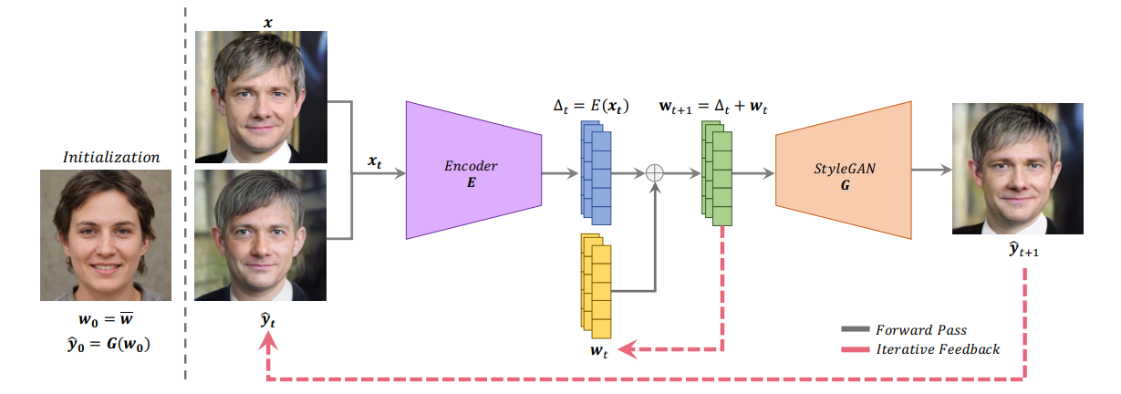
Method
■ Iteration

Slide 6
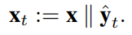
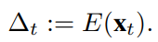
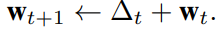
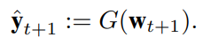
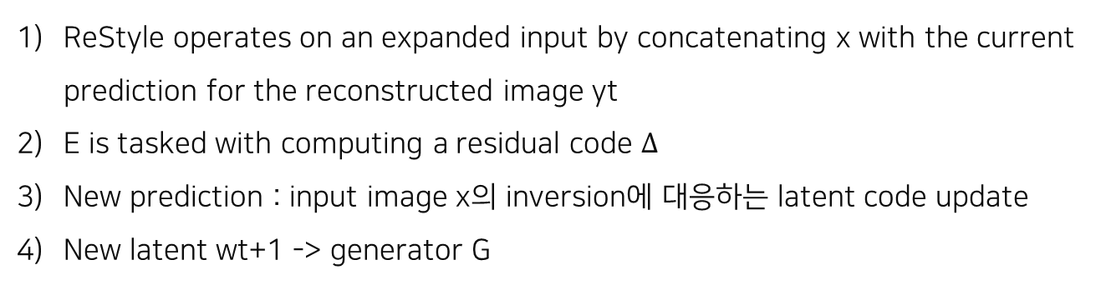
Method
■ Iteration
Initialization : w0(generator’s average style vector), y0(corresponding synthesized image)
ReStyle operates on an expanded input by concatenating x with the current prediction for the reconstructed image yt
E is tasked with computing a residual code $Δ$
New prediction : input image x의 inversion에 대응하는 latent code update
New latent wt+1 -> generator G

Slide 7
Method
■ Encoder Architecture
Restrict the PTI changes to a local region in the latent space
Pivotal tuning : ripple effect(visual quality of images generated by non-local latent codes is compromised)
original FPN
modified encoder

Slide 8
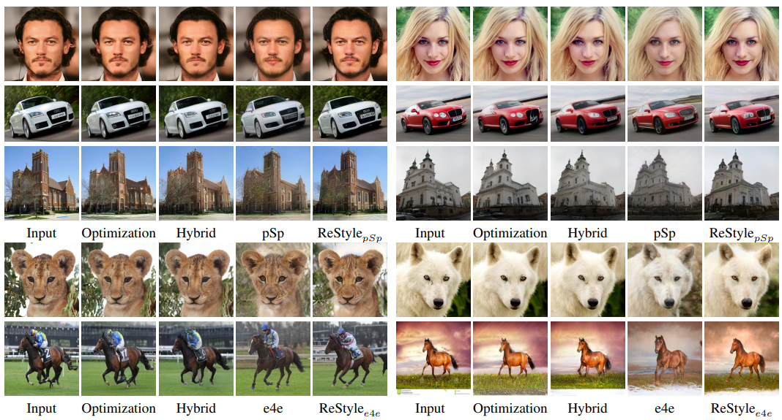
Experiments
■ Qualitative & Quantitative evaluation

Slide 9
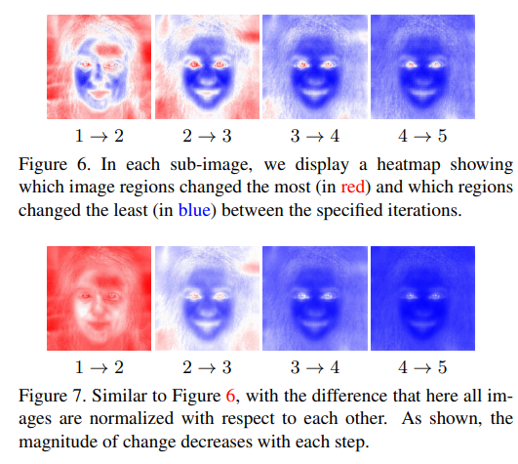
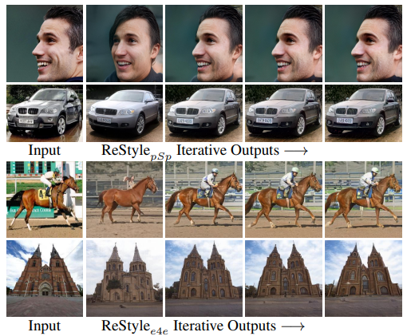
Experiments
■ Analysis
Where’s the focus?
Encoder가 각 step 마다 집중하는 영역이 다름.
Figure 6 : coarse(low frequency) to fine(high frequency), within each step
Figure 7 : 차이의 정도(처음에 많이 수정되고 step이 늘어날 수록 줄어듦)
-
ReStyle’s iterative progress
각각 step마다 점진적으로 퀄리티 상승

Slide 10
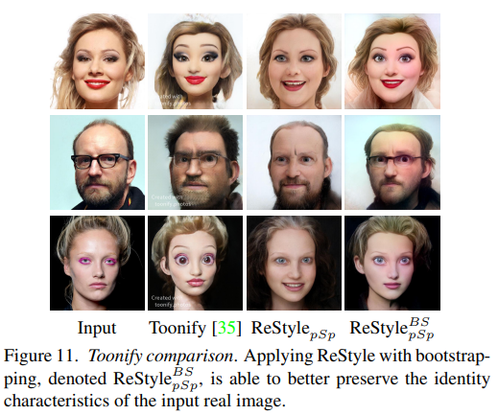
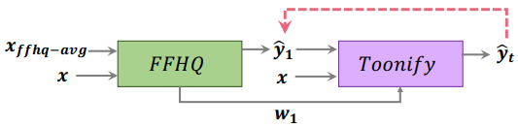
Experiments
■ Encoder Bootstrapping
Initialization : first pass the given real image to E with embedding real images into the latent space of a StyleGAN trained on FFHQ -> w1, y1
기존 방식 : i2i task는 G를 fine tuning함으로써, real image를 가장 가까운 toon image의 latent space로 project한다.

Slide 11
Kim Ha Yeon(rlagkdus705@unist.ac.kr)

